Slide 1


WASTO
A waste management website
21st october 2023

Slide 2

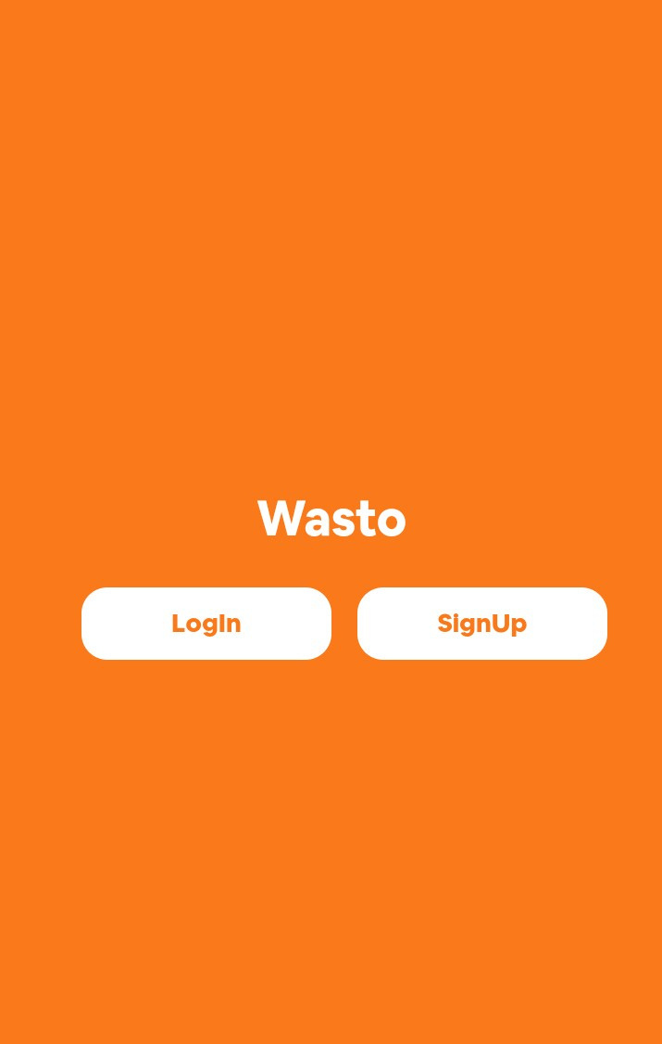

WASTO
Hi everyone!
I'm excited to introduce wasto, a new waste management mobile-friendly website that helps Eket citizens to effectively manage their waste and keep the environment eco-friendly.
wasto is a free and easy-to-us

Slide 3

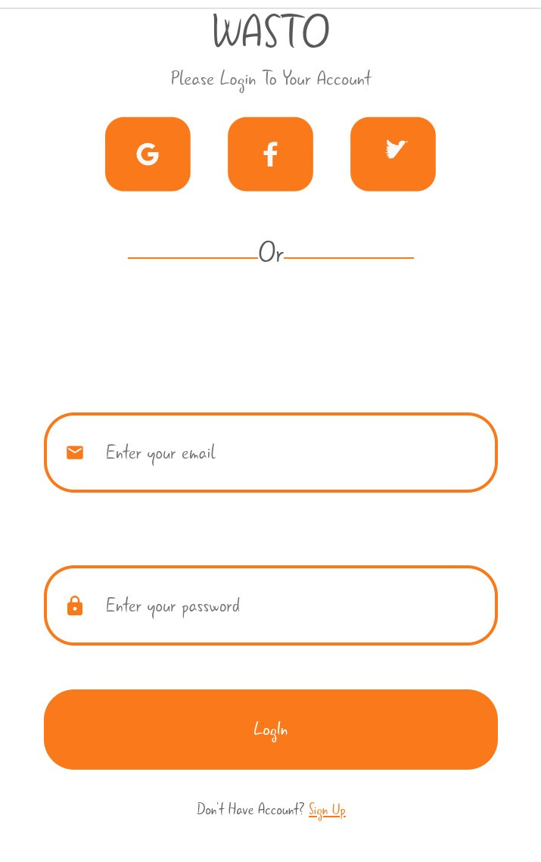
AUTHENTICATION AND WELCOME SCREEN
Upon launching the mobile website, users are welcomed with a screen that displays options for logging in and signing up. Users can either log in to their existing accounts or sign up.

Slide 4
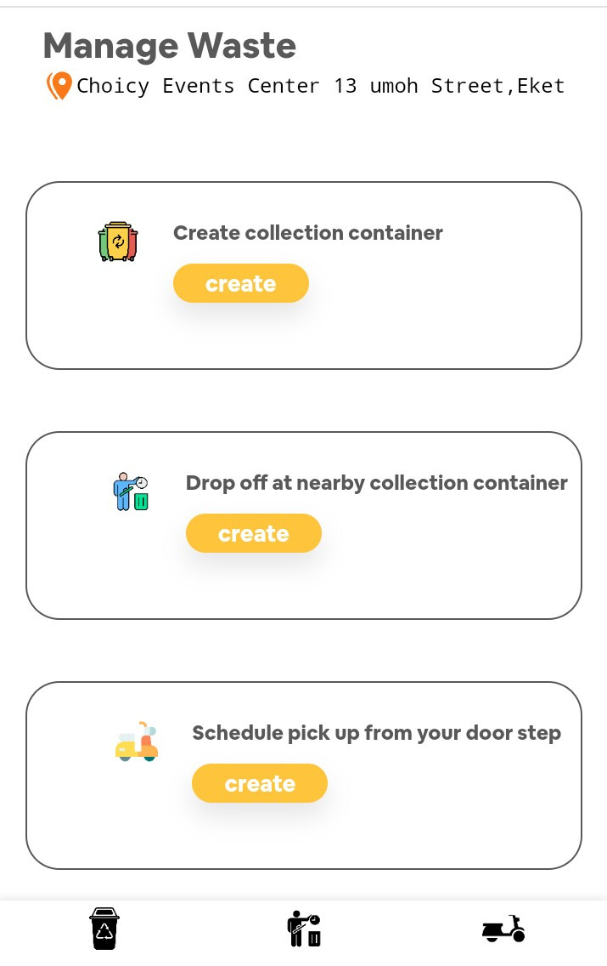
MANAGE WASTE NAVIGATION
Under the "Manage Waste" section on the home page, users can select their preferred waste management method. They have three choices: creating a collection container, dropping off waste in a nearby container, or scheduling a pickup from their home. After making their selection, users are directed to the corresponding page for the chosen method

Slide 5
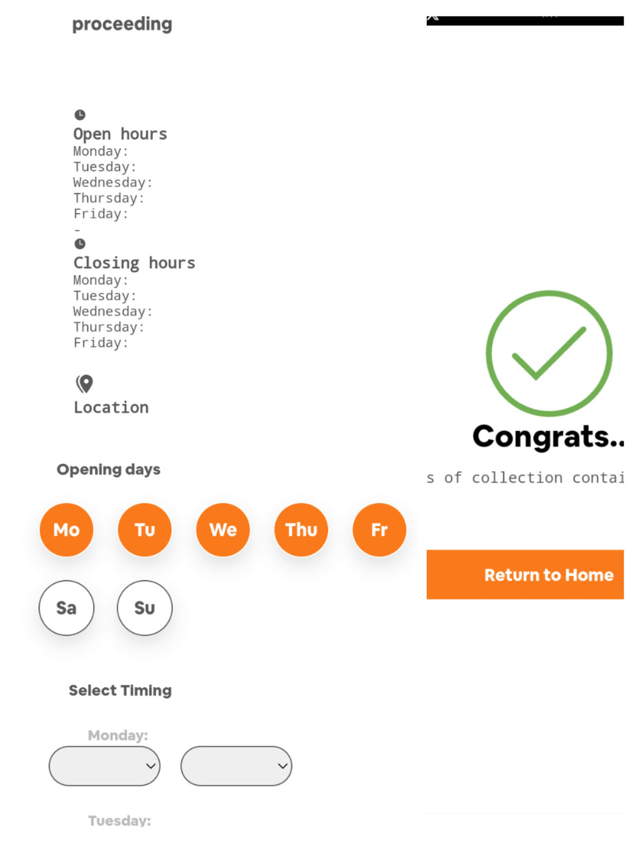

CREATE COLLECTION CONTAINER:
This section involves creating a collection container, which is one of the three waste management options. Users input the container's address, select time and days when the containers are always open and upload images for identification. The container's open hours, verification, and confirmation details are included.

Slide 6

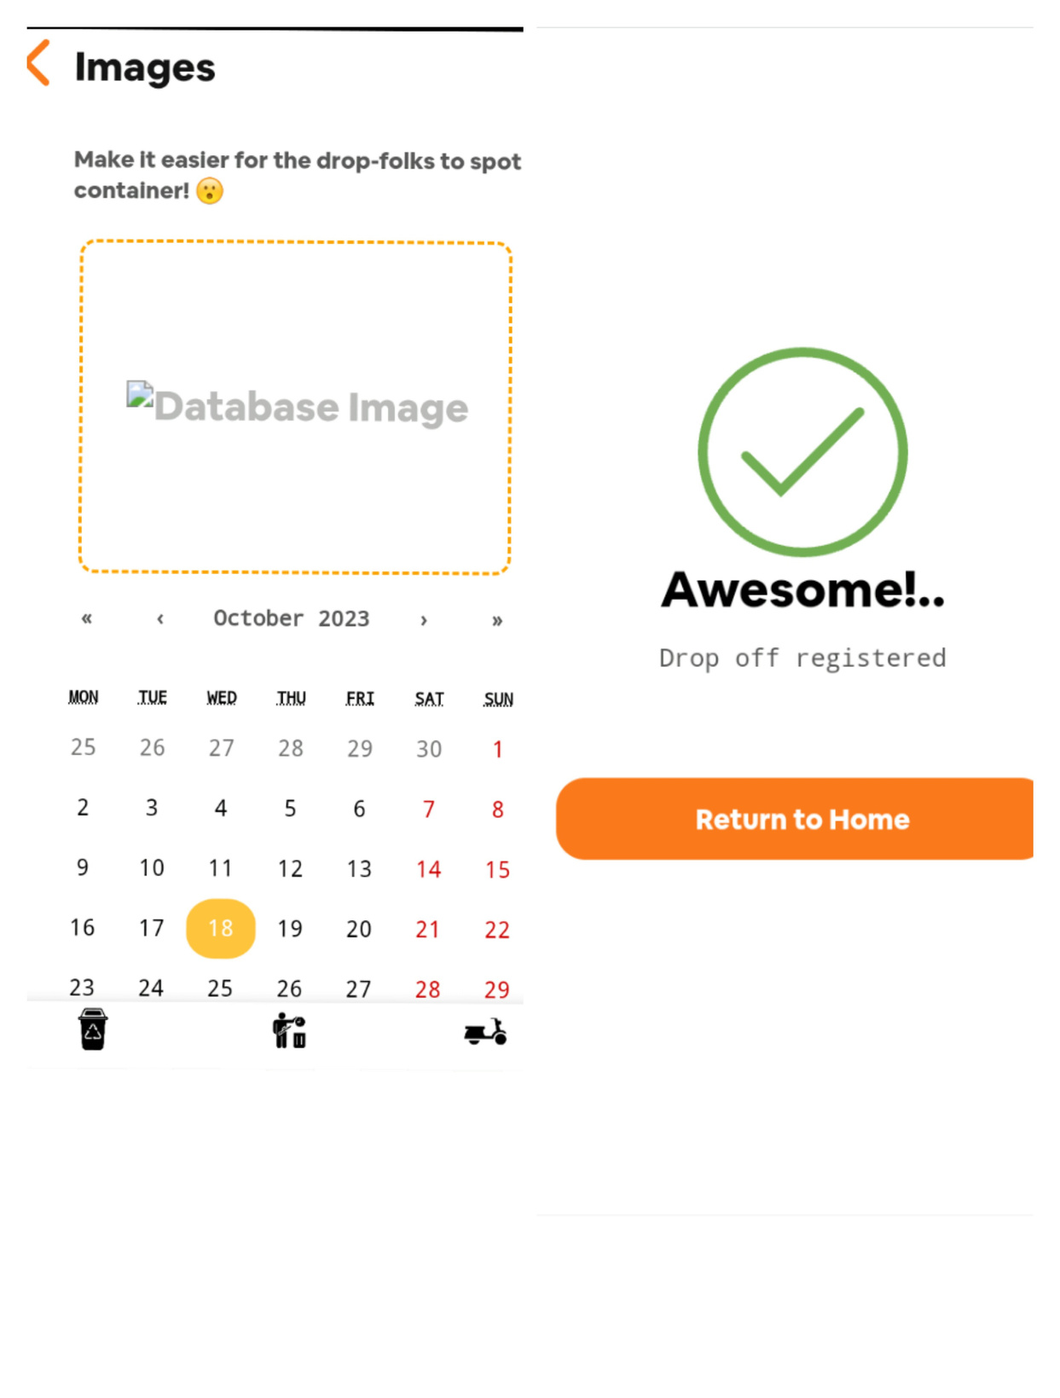
DROP-OFF AT NEARBY COLLECTION CONTAINER:
In this section, users can identify a container and can arrange for waste pickup. Users specify the pickup time, and this container is accessible to the public for waste drop-off. After the confirmation, the container is ready for pickup.

Slide 7

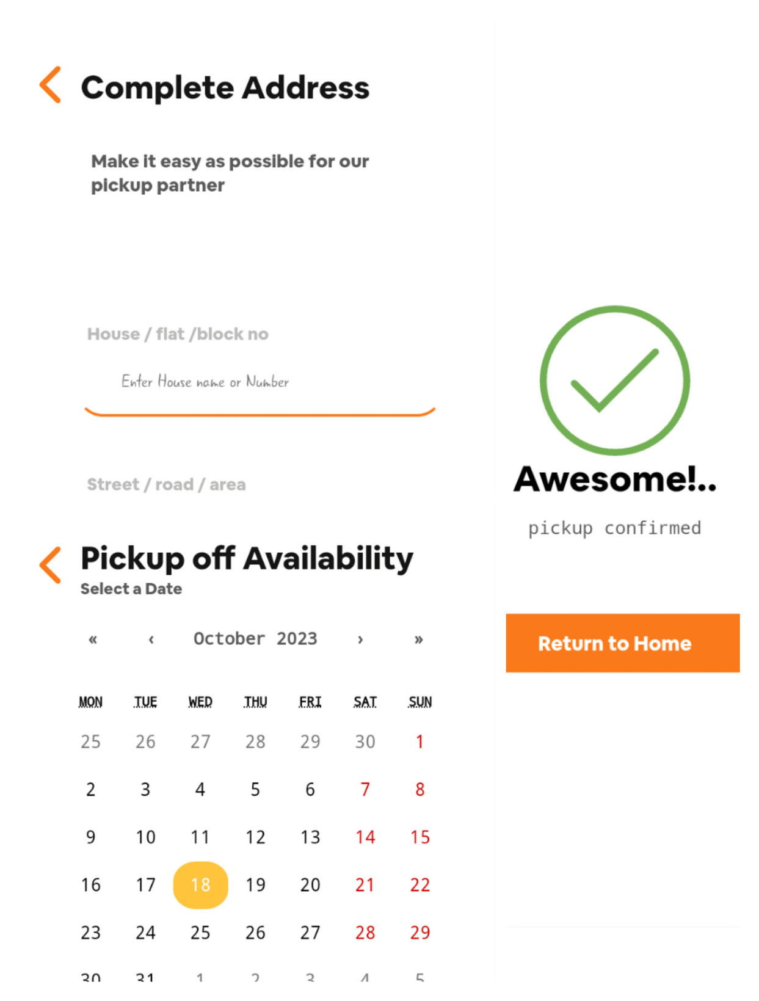
SCHEDULE PICKUP FROM HOME:
Users can create schedule through this section. Once the pickup is confirmed, users receive a confirmation notification. The confirmation includes a calendar for selecting the pickup day and time availability

Slide 8

conclusion
Effective waste management is crucial for maintaining a healthy and sustainable environment in Eket, as well as for the well-being of its residents. The management of waste includes collection, transportation, disposal, and recycling of various types of waste generated by households, businesses, and industries.

